Slide 1

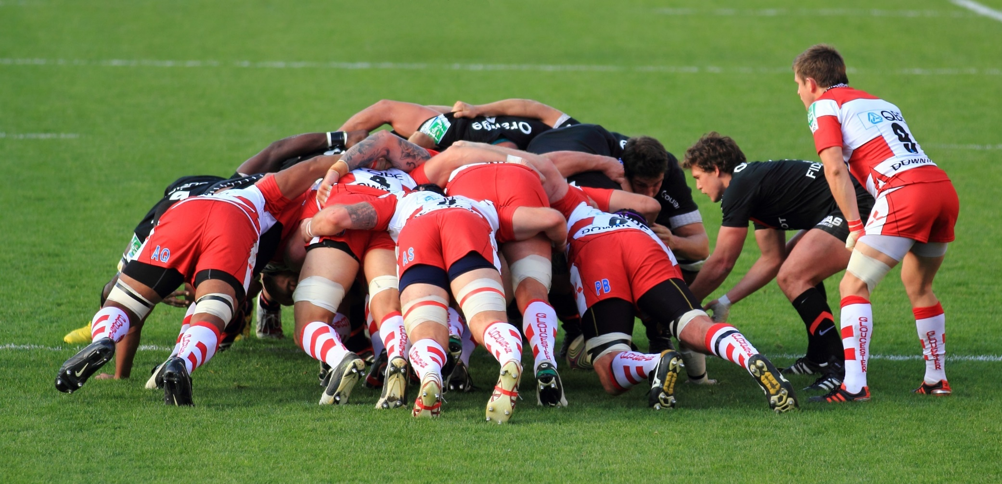
Agile Project Management Workshop By Hari Thapliyal Agilest & Project Management Trainer, Coach & Consultant MBA, MCA, PGDOM, PGDFM, CIC, PMP, PMI-ACP, PRINCE2 Trainer MCITP, MCTS, CSM, SCT, MCT, SPOC, SMC, SAMC, ZED Master Trainer
This training material is only for VGL Jaipur Participants on 14/15-Dec-18

Slide 2
Faculty & Participants An Introduction Name, Role, Experience, Expectations

Slide 3
Introspection
What is the meaning of Agile for you?
What is meaning of Agile for your customer?
Your challenges in Project
Meaning of Project Success?
# of Project you have done [ ]
# of Successful projects you worked [ ]
Why Project fails or get challenged

Slide 4
Expectation Setting

Slide 5

Working Agreements
Working Time
Break Time
Electronics
Corner Talk
Group Exercises
Participation
Our Values (for this project/workshop)
Focus
Communication
Respect
Openness
Courage
Respect
Everybody

Slide 6
Baseline Test

Slide 7
Overall Plan of This Workshop (1/5)
What is Agile and Agility
Agile Values & Principles, Scrum Values
Scrum Framework – High Level View
Scrum Roles
Characteristics of The Agile Team & Team Structure
Exercise 3 : Write Values & Principles of Your Team
Requirement Management
User Story (US), Features, Epic, Theme, INVEST Model, Acceptance Criteria
Product Backlog Creation, Grooming
Requirement Change
Exercise 4 : User story writing

Slide 8
Overall Plan of This Workshop (2/5)
Planning
Estimation of Complexity vs Efforts
US Estimation Techniques (Planning Poker, Mute Mapping)
Release Planning
Task Estimation
Sprint Planning
Daily Standup (Daily Planning)
Exercise 5 : Complexity estimation
Exercise 6
Release planning, Product roadmap, # of releases required , Length of release, Release goal.
Pick user stories as per release goal
Prioritize US in release backlog
Exercise 7
Sprint planning: Length of sprint, Sprint goal, Pick US from release backlog based on priority
Task card creation

Slide 9
Overall Plan of This Workshop (3/5)
Development & Testing
Kanban / ScrumBan Board
How Scrum Team Work as a Unit?
Within Team Interaction
Outside Team Interaction
Definition of Done
Product Build
Agile Documentation
Agile Testing/ Product Testing
Design / Architecture / Code Improvement
Exercise 8
Kanban board. US name, task name,
Kanban board Updation
Put task on Kanban board

Slide 10
Overall Plan of This Workshop (4/5)
Governance
Sprint Review
Sprint Retrospective
Metrics in Agile
Burndown & Burnup charts
Velocity Chart
Regulatory Compliances
Agile Health Checkup
Some Important Concepts of Agile Project Management
Sharing progress with Stakeholders
Exercise 9
Burn down, velocity charts
Exercise 10
Sprint Review
Exercise 11
Sprint Retrospective
Risk Management (30 mins)
Exercise 11
Risk Burndown Chart

Slide 11
Overall Plan of This Workshop (5/5)
Scaling Scrum
Different teams of the same product at same location.
Different teams of the same product at different location, time zone
Different versions of same product for different customer
Tools in Agile Project
Existing Tools/Framework
How to Implement Agile in Jira
Devops
Recap

Slide 12
Any Suggestion/Input?

Slide 13
Why this?
Standish Group Prepares Chaos Reports Regularly.
1994: Only 16% of the projects are successful, based on their triple constraints
2004: 29%
2009: 32%

Slide 14
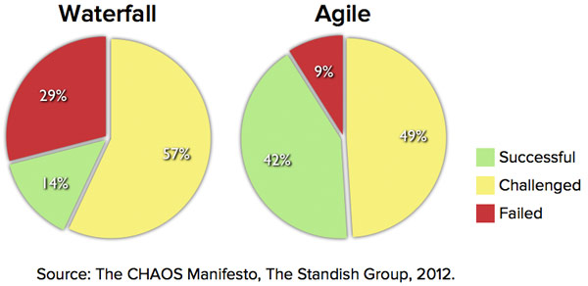
Process Success with Agile Methods
Definition of Success was left to participants. Only 8% agreed that all three constraints important for them to make a project Success

Slide 15
Overall Plan of This Workshop (1/5)
What is Agile and Agility
Agile Values & Principles, Scrum Values
Scrum Framework – High Level View
Scrum Roles
Characteristics of The Agile Team & Team Structure
Exercise 3 : Write Values & Principles of Your Team
Requirement Management: (3 hrs)
User Story (US), Features, Epic, Theme, INVEST Model, Acceptance Criteria
Product Backlog Creation, Grooming
Requirement Change
Exercise 4 : User story writing

Slide 16
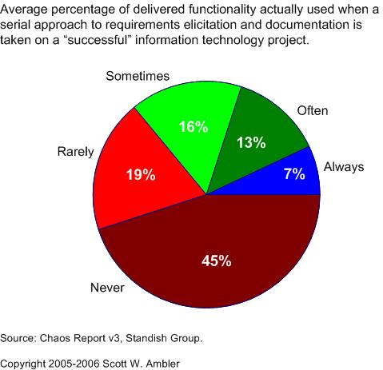
Why Agile Makes Sense?

Slide 17
Problem with Traditional Project Management
Any variance is considered as evil
Focus is on Time , Cost and Scope
Very often the project teams can be insensitive to the business case of the project

Slide 18
What is an Empirical Process
Understands the output is not controlled only by controlling input and steps
Process is defined loosely and at high level
Process learn and evolve over the period of time (adaptation)
Adaptive methods are based on empirical processes

Slide 19
What are Adaptive Methods
Scrum (Management Focused)
XP - Extreme Programming (Engineering Focused)
FDD - Feature Driven Development (Business Focused)
Crystal Methods
DSDM – Dynamic Systems Development Method
LSD – Lean Software Development (Focused on Cost of feature)
ASD – Adaptive Software Development
Many others....
They all differ from each other in terms of focus, values, practices, type of work, compliance need, complexity of product, collaboration need etc.

Slide 20
Agile Certification Market
PMI-ACP (PMI)
PRINCE2-Agile by Axelos
SCM – Scrum Certified Master by Scrum Study
CSM – Certified Scrum Master by ScrumAlliance
Each organization like Scrum Study, ScrumAlliance, Scrum.org has 3-6 certification for different role

Slide 21
When to go agile? Exploration factor
Product Requirements | Bleeding edge | Leading edge | Familiar | Well known
Erratic | 10 | 8 | 7 | 7
Fluctuating | 8 | 7 | 6 | 5
Routine | 7 | 6 | 4 | 3
Stable | 7 | 5 | 3 | 1

Slide 22


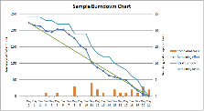

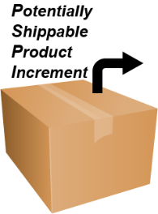
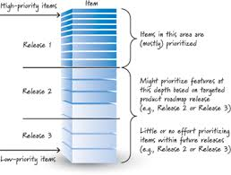
Agile Framework at a Glance
Product Owner
Burndown/Up Chart
Product Backlog
Sprint Planning
User Story | Task | Total Hours
User Story 1 |  | 24 Hrs
 | Task1 (10 hrs)
 | Task2 (6 hrs)
 | Task3 (8 hrs)
User Story 2 |  | 21 Hrs
 | Task1 (6 hrs)
 | Task2 (15 hrs)
User Story 3 |  | 34 Hrs
 | Task1 (13 hrs)
 | Task2 (12 hrs)
 | Task3 (9 hrs)
User Story 4 |  | 21 Hrs
 | Task1 (11 hrs)
 | Task2 (3 hrs)
 | Task3 (7 hrs)
User Story 5 |  | 14 Hrs
 | Task1 (12 Hrs)
 | Task2 (2 hrs)
Scrum Master
Daily Scrum
Release Planning
Sprinting
Sprint Retrospective
1-4 Weeks
Release Backlog
Sprint Backlog

Slide 23
Year | Contributer | Method/ Work | Organization
1950 | Taiichi Ohno, Ejiji Toyoda, Shigeo Shingo | Lean Manufacturing | Toyota Product System
1958 | Gerald Welnberg | TDD | Project Mercury
1968-69 |  | Iterative development (feedback driven requirements with evoling design & architecture) | IBM - Fedral System Division
1972-75 |  | Feedback Driven Refinements | US Gov (Missiles Defense, Light Airborne System, Trident Submarine)
1976 | Tom Gilb | Evo Method
1980 | Gerald Welnberg | Adaptive Programming, Small Increments
1986 | Takeuchi & Nonka | The New New Product Development Game" Published
1986 | Fred Brooks | No Silver Bullet" published
1985 | Barry Boehm | Spirl Model - Risk Driven
1995 |  | DSDM (Dynamic systems development method)
1995 | Jeff Sutherland & Schwaber | Scrum Methodlogy Paper at OOPSLA
1996 | Rational Unified Process | Rational Software acquires Objectory Process
1997 | Jeff De Luca | FDD
1998 | Alistair Cockburn | Crystal Family
1999 | Kent Back | XP Defined and published
2001 |  | Agile Manifesto at Snowbird UT
2007 | Dean Leffingwell | SAFe (Scalled Agile Framework)
2011 | PMI-ACP

Slide 24
History of Agile Development

Slide 25
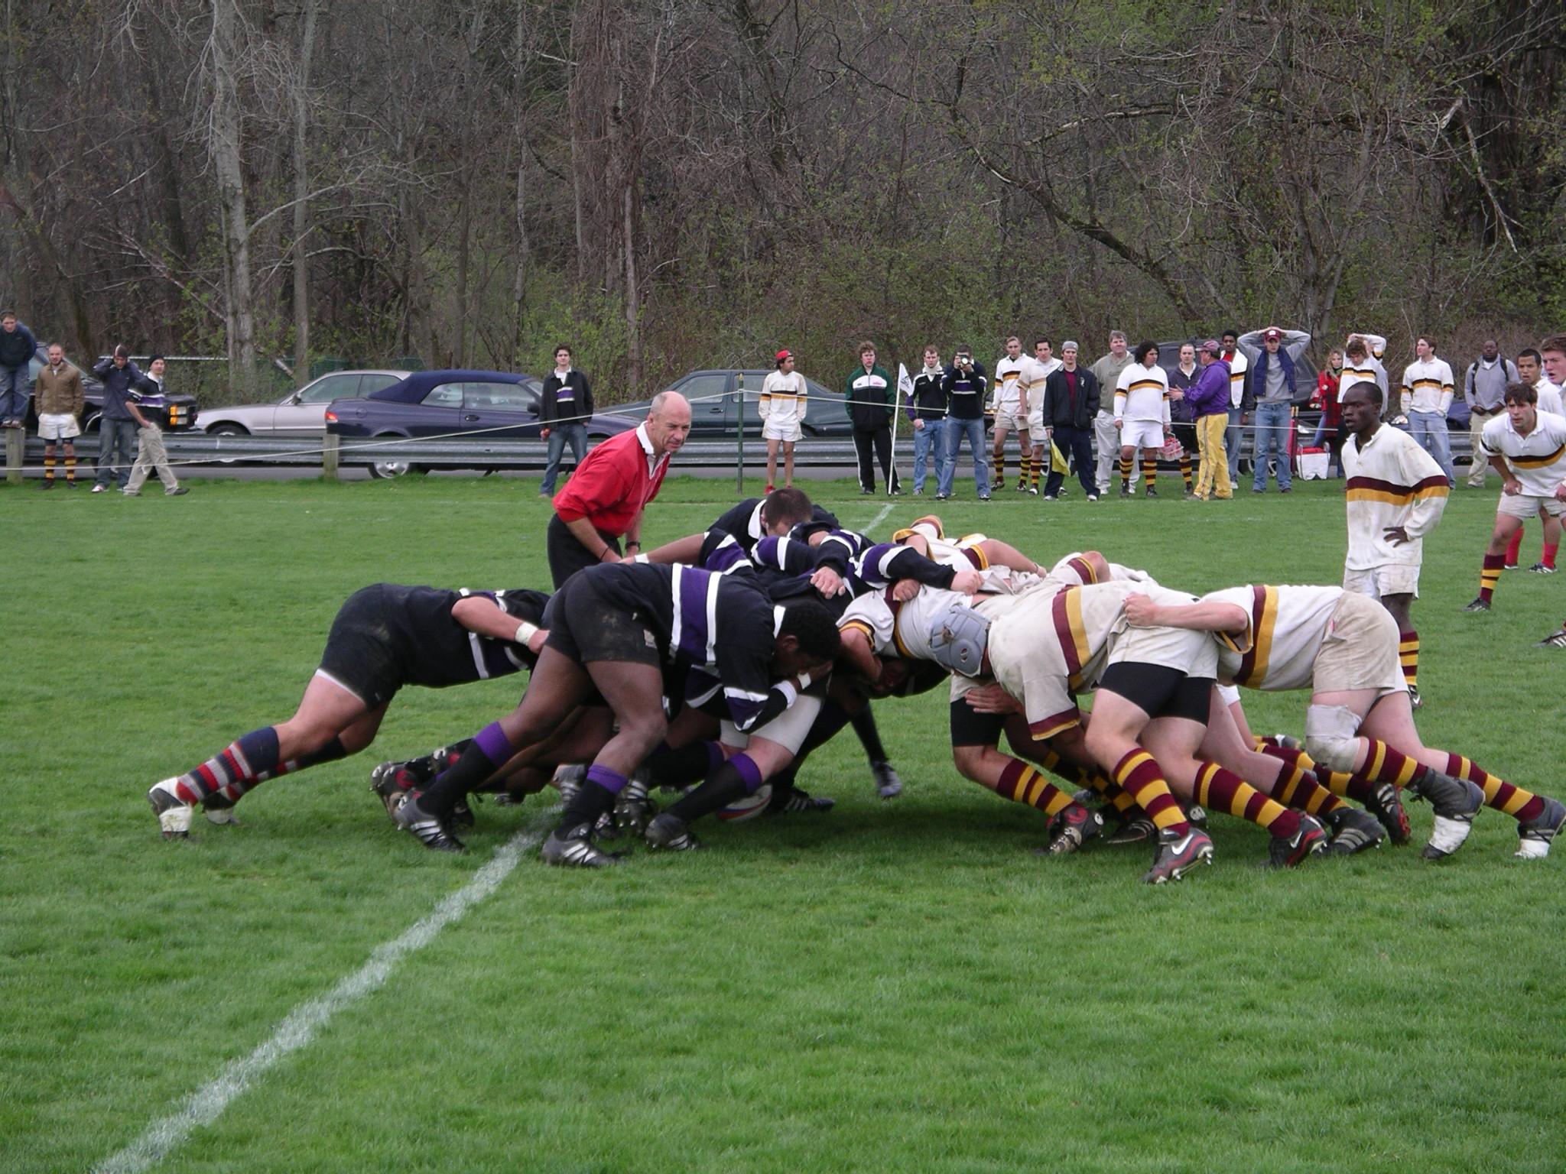
Involved People
(Chickens)
Scrum Master
Committed People (Pigs)

Slide 26
Agile is Value & Principle Based
Value : An idea which does not change, it controls your behaviour and drives you to do things in life or business. Mostly fixed, once identified and determined they do not change.
Principle: To live the values, you build it based on the principle. Compare to value less fixed. Still the are conceptual like values.
Practices: Daily activities which you perform to live the principle and value. Old practices get retired and new practices get introduced based on the need of business. More human centric.
Process: Sequence of activities with defined input and output. More mechanical in nature.

Slide 27
Manifesto for Agile Software Development
Individuals and interactions over process and tools
Working software over comprehensive documentation
Customer collaboration over contract negotiation
Responding to change over following a plan
That is, while there is value in the items on the right, we value the items on the left more.

Slide 28
The 12 agile principles
Our highest priority is to satisfy the customer through early and continuous delivery of valuable software.
Welcome changing requirements, even late in development. Agile processes harness change for the customer’s competitive advantage.
Deliver working software frequently, from a couple of weeks to a couple of months, with a preference to the shorter time scale.
Business people and developers must work together daily throughout the project

Slide 29
The 12 agile principles
Build projects around motivated individuals. Give them the environment and support they need, and trust them to get the job done.
The most effective method of conveying information to and within a development team is face-to-face conversation.
Working software is the primary measure of progress.
Agile processes promote sustainable development. The sponsors, developers and users should be able to maintain a constant pace indefinitely.

Slide 30
The 12 agile principles
Continuous attention to technical excellence and good design enhances agility.
Simplicity – the art of maximizing the amount of unwanted work not done – is essential.
The best architectures, requirements and designs emerge from self organizing teams.
At regular intervals, the team reflects on how to become more effective, then tunes and adjusts it’s behavior accordingly.

Slide 31
SCRUM Values
1. Commitment
Be willing to commit to a goal. Scrum provides people all the authority they need to meet their commitments
2. Focus
Do your job. Focus all your efforts and skills on doing the work you have committed to doing. Don’t worry about anything else

Slide 32
SCRUM Values
3. Openness
Scrum keeps everything about a project visible to everyone
4. Respect
Individuals are shaped by their background and their experiences. It is important to respect the different people who comprise a team
5. Courage
Have the courage to commit, to act, to be open and to expect respect

Slide 33
Scrum is..
Founded on empiricism
Believes knowledge comes from experience
Believes in making decisions based on what is known
Iterative incremental approach
Risk control
Transparency
Adaptation

Slide 34
Values & Principle
Form Project Based Team
Team should draft their values and principles on Chart Paper
Guidelines: Ensure every team member understand these and interpret correctly especially in the case of conflict, confusion

Slide 35
Characteristics of Agile Team
Agile team is value and principle driven
Agile team is self organizing
Agile team is self motivating team
Agile team is delivery driven and not task driven
Agile teams are not department driven
Agile team do not promote heroism

Slide 36




Team Strategies
Feature 1
Feature 2
Feature 3
Feature 4

Slide 37
Team Strategies
Client Dev.
Server Dev.
Mainframe
Mobile Dev

Slide 38

Team Strategies
Testing Team
Dev. Team
UI Team
BA Team

Slide 39
Introspection
How to form team? How to interact with other team members? When
Project Teams sits at multiple Geographical locations
Team is distributed across different vendors.
Product owner and the team is at different TZ.

Slide 40
Scrum Roles

Slide 41
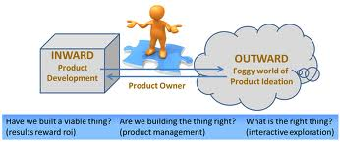
Product owner
Controls the product backlog
Product Backlog grooming
Prioritizes the features to be developed
Conducts demo
Business value justification
Can cancel sprint
Participate in sprint planning, daily scrum, retrospective
Helps team in understanding requirements

Slide 42

Scrum Master
Responsible for the success of scrum
Scrum values, practices and rules are enacted and enforced
Represents the management and the team to each other
Conducts all daily scrums
Removes impediments

Slide 43
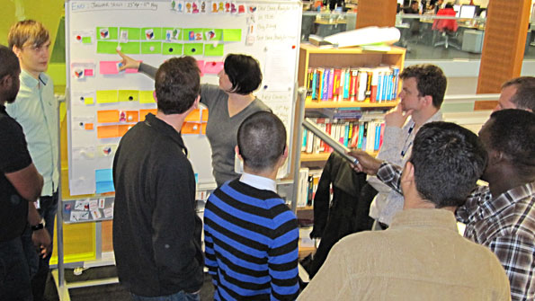
Scrum Teams
A team commits to achieving a sprint goal. The team is accorded full authority.
Team size is 7+/- 2
Cross functional
No titles
No hierarchy
It does not mean seniority should not be respected. Local culture, value system, organization culture impacts the structure a lot

Slide 44
Sprint
In XP it is also called “Iterations”
Fixed duration for which team commits a potentially shippable product to Product Owner
Product is understood, designed, coded, tested and demo and delivered in a sprint.
The duration can vary from 1-6 weeks depending on agile method chosen and project characters
In Scrum ideal duration is 4 weeks.
The duration is NOT variable and it is decided at the start of project. What if it vary??
If work committed cannot be done in a sprint work duration cannot be extended but work is moved into next sprint
No extra time for testing and bug fixing

Slide 45
Product Backlog

Slide 46
What is a product backlog?
A wish list of features (user stories)
Continuously growing (product backlog grooming)
Owned by the product owner
Prioritized (based on risk, cost, value)
Tells you what need to be tested?
When stops growing – indication that the product is reaching end of life !

Slide 47
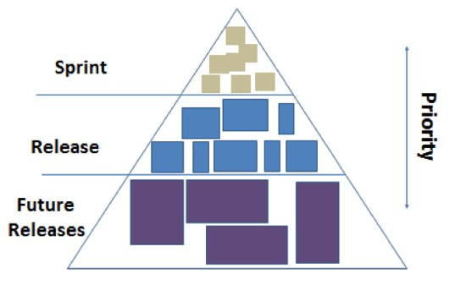
Product backlog
ID | Theme | As a/an | I want to... | So that... | Notes | Priority | Status
2 | Deposits | Cachier | credit customer account for the deposited with me | Customer account reflects the new balance |  | 1 | Done
3 | Deposits | Cachier | update the wrongly entered deposit amount | Customer account reflects the correct amount |  | 2 | Done
4 | Deposits | Auditor | know whether amount is credited into customer's account | I can tell customer the status |  | 6 | Todo
5 | Non-Functional | Manager | Any page which is marked as super confidential should not be printed on unauthorized printer |  |  | 3 | Done
6 | Non-Functional | Cachier | My cash entry page should load in 2 sec |  |  | 8 | Done
7 | Archive | IT Admin |  |  |  |  | Done
8 | Security | Cachier |  |  |  |  | Done
9 | Security | Manager |  |  |  |  | Done

Slide 48
Product Backlog Prioritization Techniques

Slide 49
Relative Prioritization & Ranking Methods
1 Forced Ranking Techniques
Force each customer to assign unique rank number to each requirement
Requirements | Stakeholder1 | Stakeholder2 | Stakheolder3 | Total | Ranking
Req#1 | 1 | 5 | 4 | 10 | 2
Req#2 | 2 | 4 | 5 | 11 | 1
Req#3 | 3 | 3 | 3 | 9 | 3
Req#4 | 4 | 1 | 2 | 7 | 5
Req#5 | 5 | 2 | 1 | 8 | 4
Highest score lowest Rank

Slide 50
Relative Prioritization & Ranking Methods
2. 100 Point Method
Each stakeholder is given 100 points and they can use these points to buy the requirements they want
Requirements | Stakeholder1 | Stakeholder2 | Stakheolder3 | Total | Ranking
Req#1 | 0 | 20 | 30 | 50 | 3
Req#2 | 30 | 10 | 40 | 80 | 2
Req#3 | 50 | 20 | 20 | 90 | 1
Req#4 | 20 |  | 10 | 30 | 4
Req#5 | 0 | 50 | 0 | 50 | 3

Slide 51
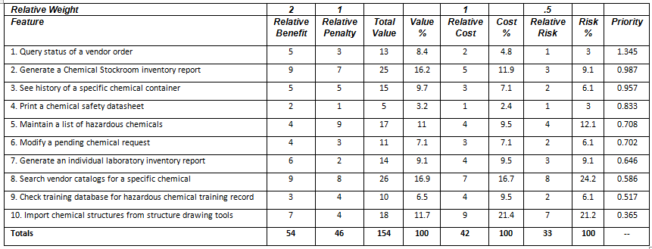
Multiple Parameter Based Prioritization
Done by Customer
Done by Developer
3. Multi Parameter Based
value percentage / (cost percentage * cost weight) + (Risk percentage * Risk weight)
Done by Customer
Potential negative impact of not doing the feature
Notes:
http://msdn.microsoft.com/en-us/library/hh765981.aspx

Slide 52
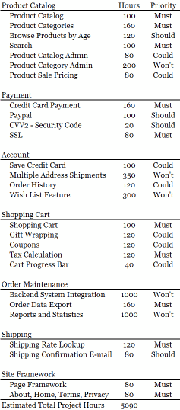
MoSCoW Prioritization
4. MoSCoW Prioritization
 | Hours | % of Total Hours
Must Have | 1200 | 56%
Should Have | 320 | 14%
Could Have | 660 | 29%
Tota Hours | 2240
Total Hours/Time box |  | 101%
Must have hours/Time Box |  | 57%
MoSCoW Prioritization
Mo = Must Have
S = Should Have
Co = Could Have
W = Wouldn’t have now
Notes:
http://www.websitehoncho.com/2011/10/moscow-prioritization-isnt-from-russia.html

Slide 53
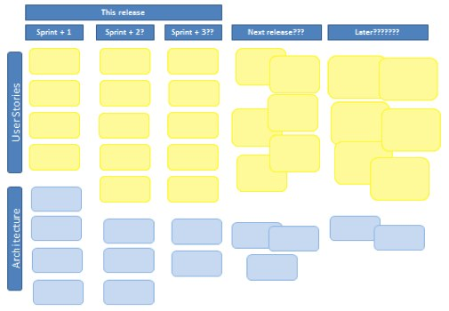
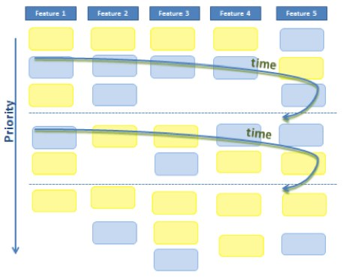
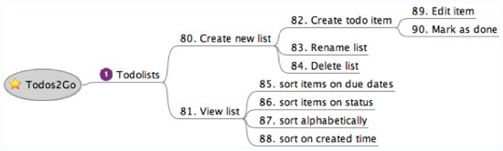
Visualize Your Product Backlog

Slide 54
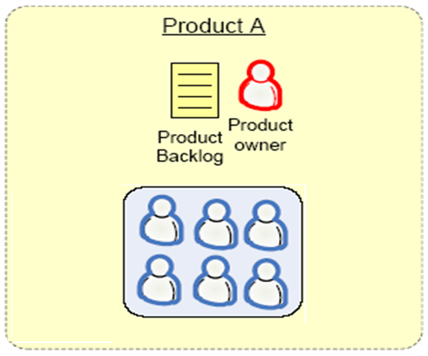
1 Product Owner – 1 Product Backlog
Ideal

Slide 55
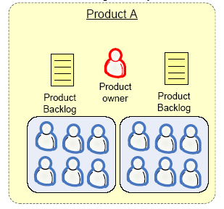
1 Product Owner – 2 Product Backlogs

Slide 56
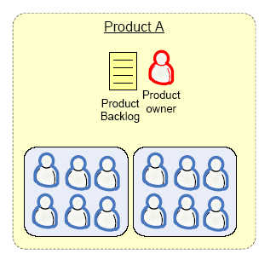
Multiple Product Owners, 1 Product Backlog

Slide 57
User Story

Slide 58
User story
A user story concept is kernel of Agile Project Management
A user story is work which a user want system to accomplish because it meets some of her/his objectives.
A user story is not functional specification document. It is a promise of product owner to the team that he will explain the requirements in details when the team is working on this
User story template : “As a user I want to accomplish something so that business value”
Every user story must have acceptance test cases

Slide 59
3C of User story
Card
Conversation
Confirmation

Slide 60
Types of User Stories
Business user story
“As a class teacher I want to mark attendance of student so that we can issue them certificate”
Bug user story
“An error message is displayed whenever I try to save file in pdf format”
Technical user / Technical Spikes story
“Research a search component in .NET3.5 which is fit for our application”
Non-functional user story
“The Student Affairs Information System is up and running 99.9% during the registration time period defined in the Academic Calendar.”
Documentation user story
“Develop a user manual for teachers to use teacher module”

Slide 61
Theme, Epic, Feature, Story, Task
Epic is a collection of features. An epic is typically 1-3 months in duration
Feature is collection of stories. A feature is typically 2-4 weeks in duration
User-story is smallest unit of requirement created from features. A user-story is typically less than a week in duration
Task are smallest unit of executable items which team members assign to themselves to complete a user story. A task is typically of 8 hours in duration
A group of related user stories is known as theme

Slide 62
I.N.V.E.S.T Model of User Story
I – Independent
N – Negotiable
V – Valuable to users / customers
E – Estimatable
S – Small
T – Testable

Slide 63
Techniques to Identify User Stories
User interviews
Questionnaires
Observation
Story writing workshops

Slide 64
Exercise (User Story)
Accounting Application
In a group write user stories.
A story in a card.

Slide 65
Overall Plan of This Workshop (2/5)
Planning
Estimation of Complexity vs Efforts
US Estimation Techniques (Planning Poker, Mute Mapping)
Release Planning
Task Estimation
Sprint Planning
Daily Standup (Daily Planning)
Exercise 5 : Complexity estimation
Exercise 6
Release planning, Product roadmap, # of releases required , Length of release, Release goal.
Pick user stories as per release goal
Prioritize US in release backlog
Exercise 7
Sprint planning: Length of sprint, Sprint goal, Pick US from release backlog based on priority
Task card creation

Slide 66
Estimation

Slide 67
The Estimation Scale
Complexity assessment is never in arithmetic progression
0,1,2,3,5 and 8 (Fibonacci/Hemchandra series)
1,2,4 and 8 (Geometrical increase)
Fruit Size
T Shirt Size

Slide 68
Most Common Techniques
Planning Poker
Mute Mapping
Wideband Delphi
Relative Size Estimation
You Use either or any combination of below techniques to above methods.
Expert Judgement
Analogy
Bottom Up
Top Down

Slide 69
Output of Estimation Workshop
Estimation of work happens in story points.
User Story # Story Points
Do not estimate durations but complexity
Visualize complexity in terms of # of steps, volume, # of dependencies etc.
Duration cannot be estimated till the time we know the detail of user story. It happens in sprint planning.
Simple things can take more time and vice versa.

Slide 70
Story points to schedule
Understand
Velocity,
Duration,
Elapsed time,
Productivity,
Availability of resource,
IEH (ideal engineering hours)
Before you commit the schedule

Slide 71
Exercise - Estimation
Mute Mapping

Slide 72
Exercise - Estimation
Planning Poker

Slide 73
Exercise - Estimation
Relative Size Estimation

Slide 74
Exercise - Estimation
Wideband Delphi

Slide 75
Release Planning

Slide 76
Release Planning
First Time
Develop a Product Backlog (it may not be final but enough USs to create first release)
Prepare Product Roadmap
Determine # of releases required
Length of Release
Goal of each release
At the start of every Release
Define Release Goal
Determine MMF (Minimum Marketable Features)
Prioritize USs in Release backlog
Guess a velocity (velocity get stabilized after 4-6 sprints)
Determine Number of Sprints Required for the current release

Slide 77
Release Sprint
Sprint1
Sprint2
Sprint3
Sprint4
Sprint5
Sprint6
Sprint7
Release Sprint /Hardening Sprint
Scrum
During a “release sprint”
No extra feature is added
Team prepares a product for release
Final system testing and fixing system issues
Documentation

Slide 78
Sprint Planning

Slide 79
Sprint Planning
What is this?
First define goal of the sprint before you start sprint planning
When ?
Who can participate?
How much time is required?
What is the outcome?

Slide 80
Output of sprint planning meeting
A sprint goal
A list of team members, and their commitment levels
A sprint backlog
All Engineering task are identified for every US selected for the sprint
A sprint backlog is list of all tasks for business-USs or non-business USs
A defined sprint demo date
A defined time and place for the daily Scrum

Slide 81
Non programming tasks in Sprint
Example of non-programming tasks that often need to be done in a sprint
Set up a test environment
Clarify requirements
Discuss deployment details with operations
Write deployment documents (release notes, RFC, or whatever your organization does)
Contact with external resources (GUI designers for example)
Improve build scripts
Further breakdown of backlog items during the sprint.
Identify key questions from the developers and get them answered

Slide 82
Task Card on Kanban
Task # Task type
Project# | Owner
Task Description | Efforts
Start Date | Finish Date
R Start Date | R Finish Date

Slide 83
Introspection
How to do sprint planning when Support and Dev team is common, it affects sprint backlog.
One of the team members is unable to complete his tasks on time. What can be done?
The team is lagging behind. As a scrum master what should you do?
A tester wants to do coding. What needs to be done?.
PO want to add some more user story in the sprint. What to do?
PO want to modify a user story in the current sprint. What to do?
PO want to modify a user story in the future sprint. What to do?
PO want to remove a user story in the current sprint and want to add some another user story in the current sprint. What to do?

Slide 84
Daily Standup

Slide 85
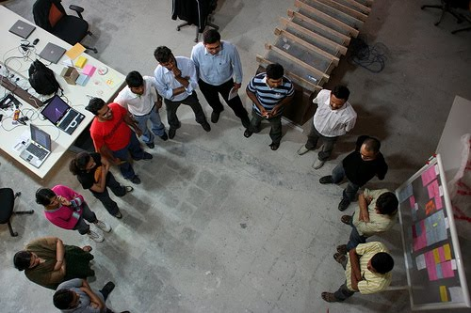
Daily Standup
Information sharing session
Re-planning and risk assessment session
Duration: 15 min
One person max 2 min
One person at a time
No status update
No problem resolution
Information sharing with 3 question
No Q/A rounds
No management interruption
Management people may be invited to avoid other unnecessary meetings
Only Scrum Team can talk

Slide 86
3 Questions of Daily Scrum
What did you do yesterday
What will you do today?
What obstacles are in your way?

Slide 87
Exercise
A video of Daily Standup
Learning from clip?

Slide 88
During the scrum meeting ….
If required the teams can revise their estimates
No explanation (Just information Sharing)
Update your burn down chart before scrum meeting start
Must discipline yourself to finish the update in structured way in 2 mins.

Slide 89
Questions about Scrum meetings?
Why daily?
“How does a project get to be a year late?”
“One day at a time.”
Fred Brooks, The Mythical Man-Month.
Can Scrum meetings be replaced by emailed status reports?
No
Entire team sees the whole picture every day
Create peer pressure to do what you say you’ll do

Slide 90
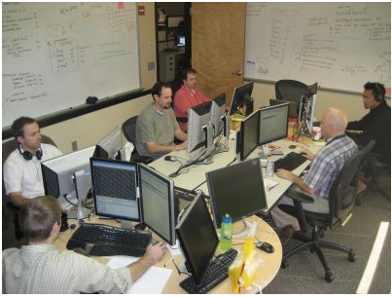
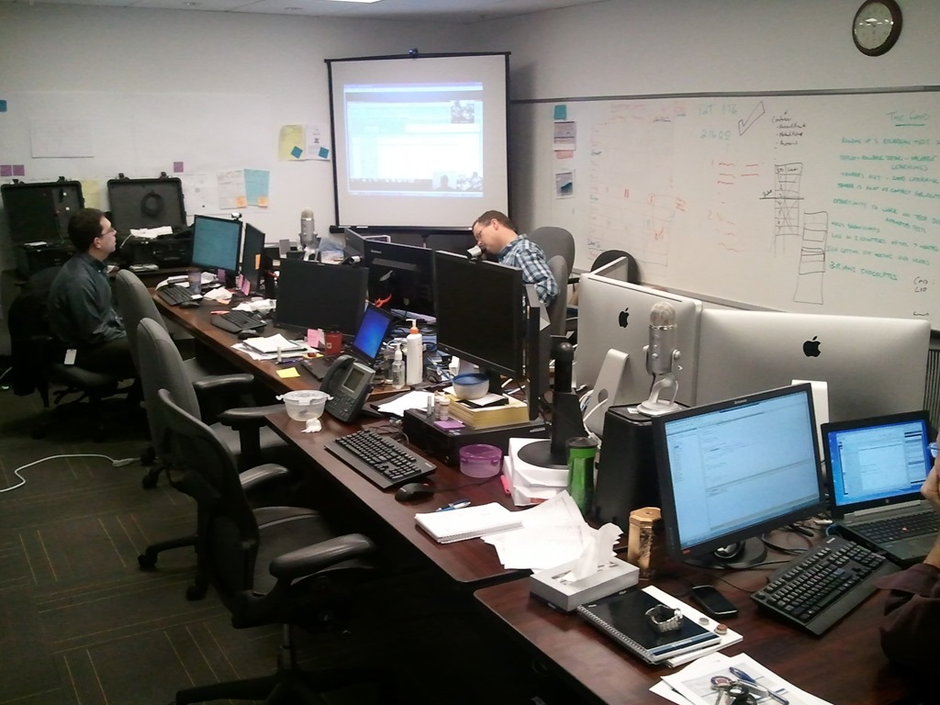

Agile Team Space

Slide 91
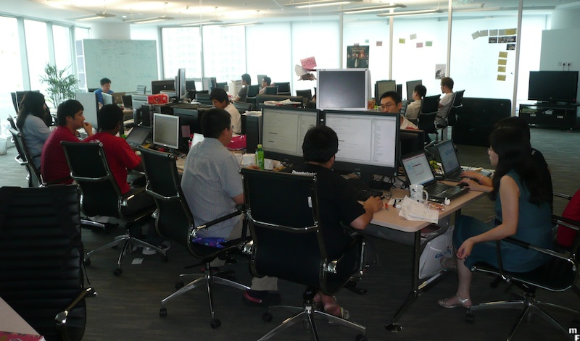
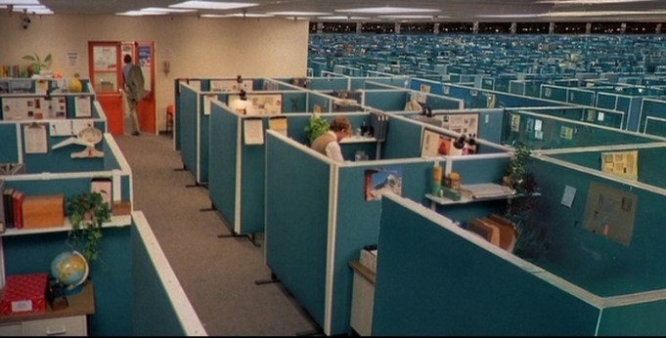

Agile Team Space

Slide 92
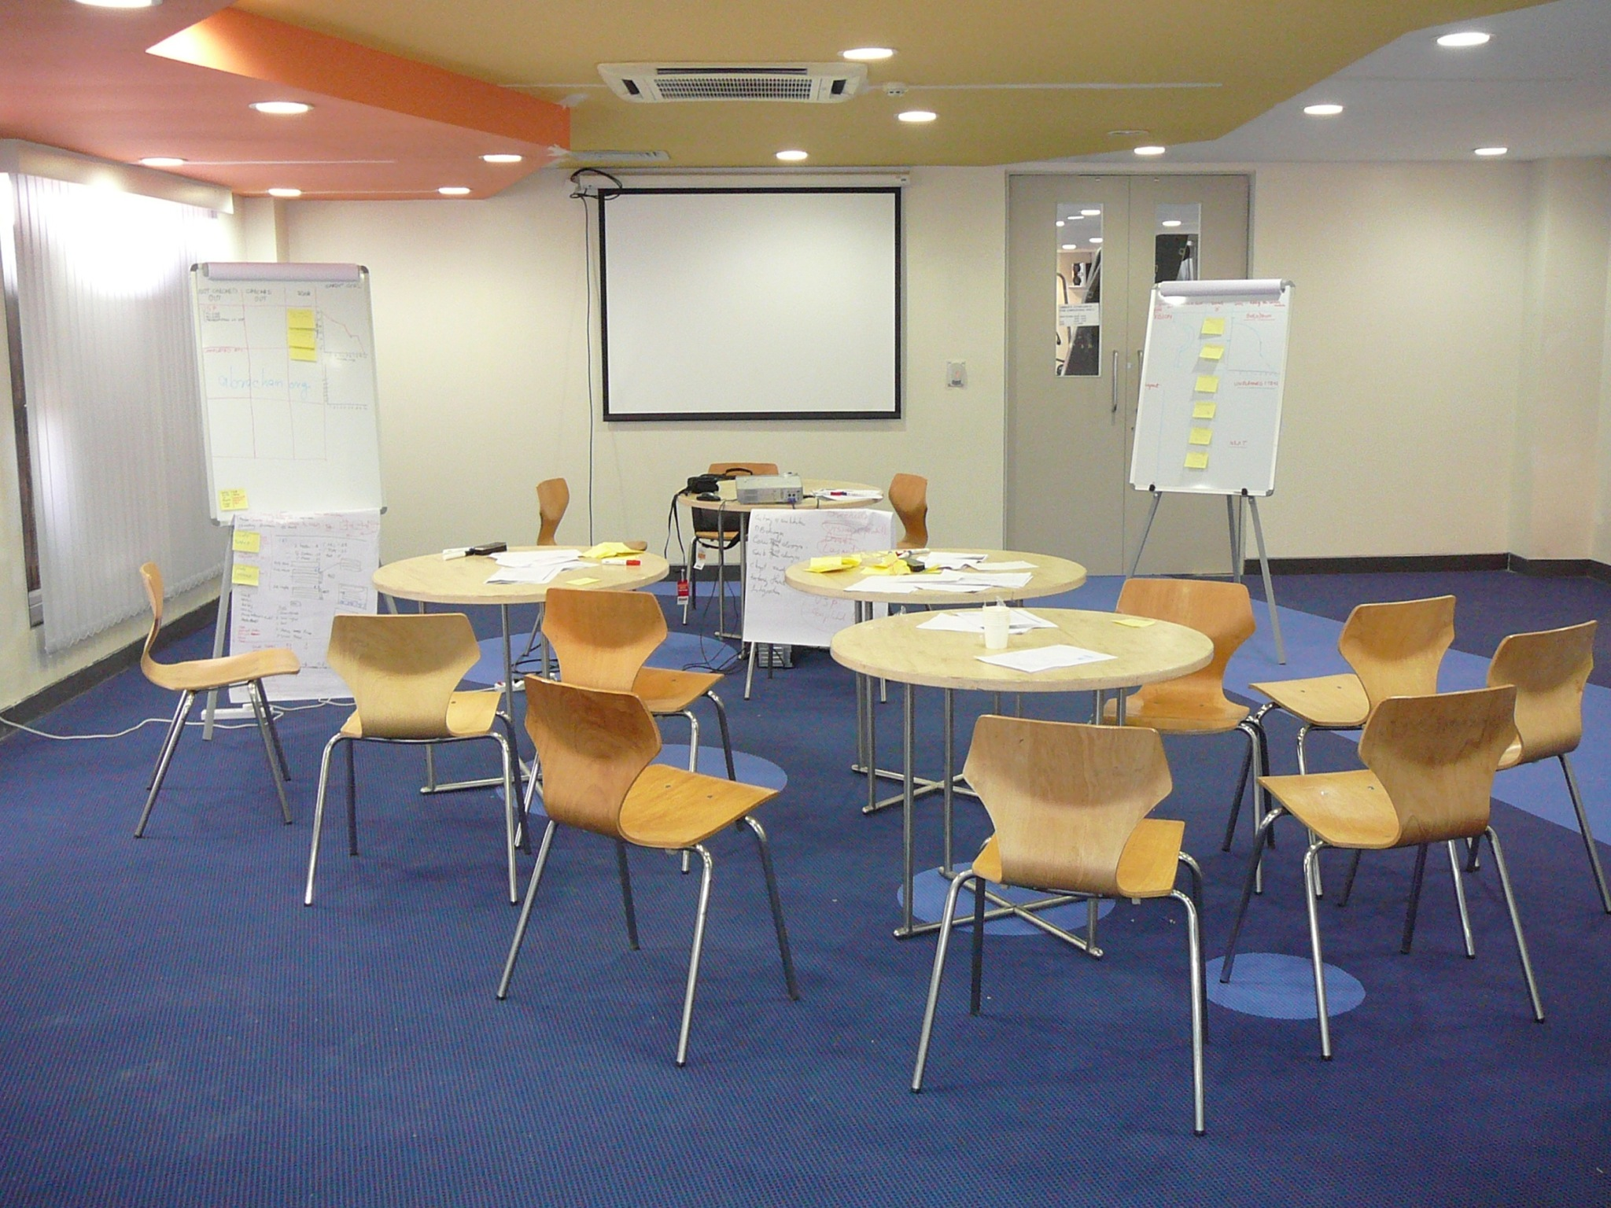
Scrum Meeting Room

Slide 93
Introspection
You are supposed to attend a scrum meeting at 10.a.m. The time now is 9.45 a.m and you are held up in a traffic jam. What will you do?

Slide 94
Overall Plan of This Workshop (3/5)
Development & Testing
Kanban / ScrumBan Board
How Scrum Team Work as a Unit?
Within Team Interaction
Outside Team Interaction
Definition of Done
Product Build
Agile Documentation
Agile Testing/ Product Testing
Design / Architecture / Code Improvement
Exercise 8
Kanban board. US name, task name,
Kanban board Updation
Put task on Kanban board

Slide 95
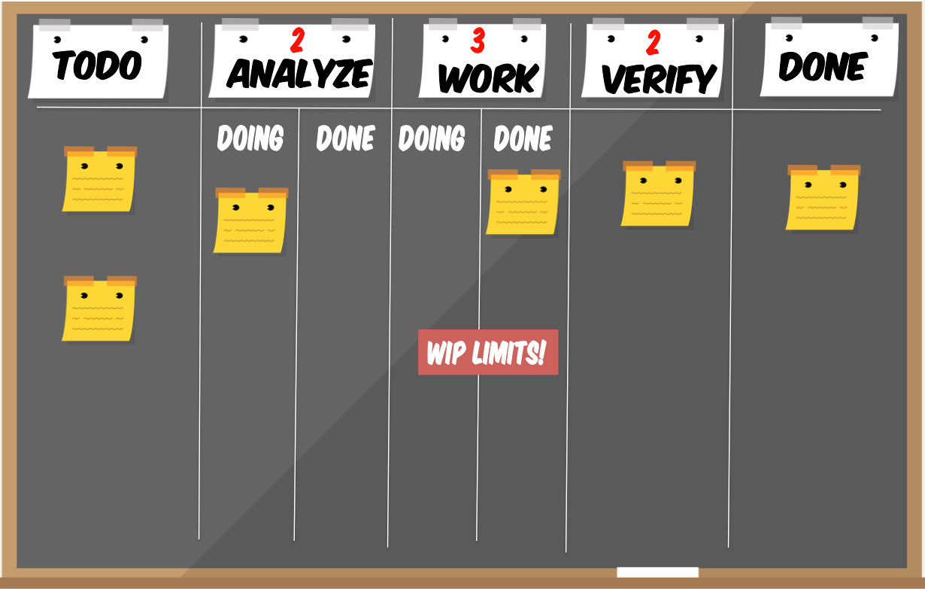
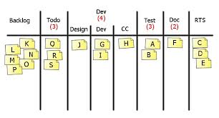
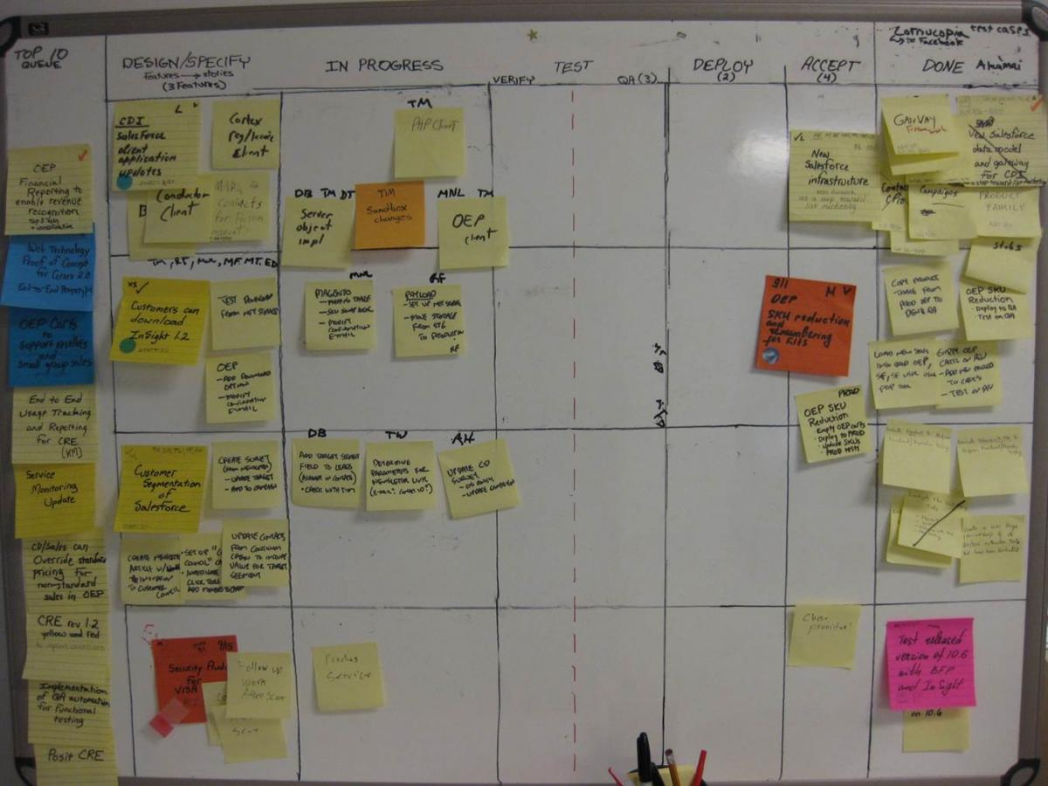
Scrum Board
Scrumban/Kanban
Yellow: Stories
Green: Tasks we created at Sprint planning
Red: Tasks that were created after Sprint planning

Slide 96
How Team Communicate
How Scrum Team Work as a Unit?
Do not think as unit task or engineering task but as user story, which customer value
Within Team Interaction
All Scrum Team Member communicate Face to face
Outside Team Interaction
Scrum Master works as firewall for the scrum team

Slide 97
Definition of Done (DoD)
The DoD changes over time. Organizational support and the team’s ability to remove impediments may enable the inclusion of additional activities into the DoD for features or sprints.
Continuous Integration (CI) helps you validating the “Doneness”
There are 3 level of DoD
Story DoD
Iteration DoD
Release DoD

Slide 98
Definition of Done (DoD)
Story “Done”
Unit test should provide 60-70% test coverage
Story is either written in pair or reviewed by peer
All code checked in
All unit code passed
All acceptance test case passed
Story accepted by owner

Slide 99
Definition of Done (DoD)
Iteration “Done”
Iteration should have defined Iteration Goal
All acceptance test cases should run for all user stories in Iteration
All stories completed must be accepted by the product owner
Defects identified are fixed or planned for future
Code performance is tested and accepted
If database is involved then database script should be available, automated and tested
Backup of iteration work product is taken

Slide 100
Definition of Done (DoD)
Release “Done”
Release should have defined Release Goal
Product has formal release date
Product is deployed on staging area
Stress testing done and results accepted
All non-functional requirements are tested and results accepted
Required documentation is available
Release should not have any known bug

Slide 101
Agile Product Build
Build complete product, all the time
One button should produce needed documentation, build the product executables, create installation materials, produce test results and tested components
Build should also work from command line
Everyone in team should use the same build process

Slide 102
Agile Documentation
Maximize stakeholder investment. Produce document only when
It is needed by a stakeholder
Needed to define contract model
You need to think something in many iterations involving multiple groups
It is needed for external communication
Document only those things which are least likely to change
First identify the specific customer of the document
The document facilitates in estimating
Sufficiently index, details, accurate and consistent

Slide 103
Agile Testing
All code must have test cases, ideally they should be created earlier
Unit tests should be executed during automated build
A build should be performed many times a time, ideally whenever anything is checked-in or committed to configuration server
If anybody’s code causing crash he should be informed immediately and that person should fix that problem first
All unit test must pass before code can be released

Slide 104
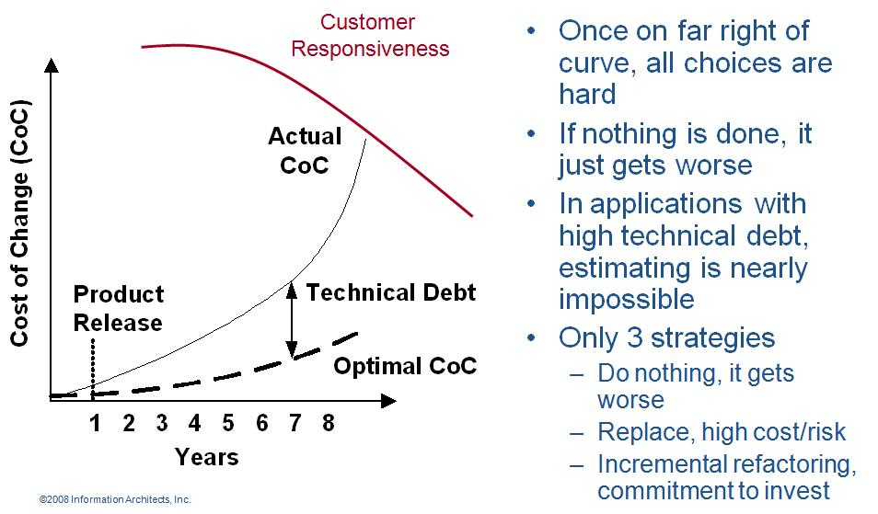
Design / Architecture / Code Improvement/ Refactoring
Agile programmer writes simple and bare minimum code they do not complicate the code
Down the line structure the code without changing its behavior. It helps in improving the quality (maintainability, readability) of code

Slide 105
Overall Plan of This Workshop (4/5)
Governance
Sprint Review
Sprint Retrospective
Metrics in Agile
Burndown & Burnup charts
Velocity Chart
Regulatory Compliances
Agile Health Checkup
Some Important Concepts of Agile Project Management
Sharing progress with Stakeholders
Exercise 9
Burn down, velocity charts
Exercise 10
Sprint Review
Exercise 11
Sprint Retrospective
Risk Management (30 mins)
Exercise 11
Risk Burndown Chart

Slide 106
Sprint reviews
Four hour informational meeting
Demo of the product increment that is built during the sprint
Attended by
Management
Customers
Users
Product owner
Scrum master is responsible for organizing and coordinating

Slide 107
Exercise
Sprint Review Video
Learning from Clip?

Slide 108
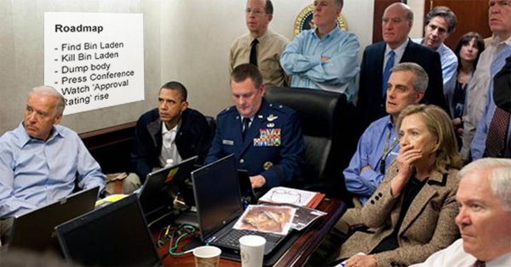
Product Demo

Slide 109
Sprint retrospectives
What went right
What went wrong
Techniques for Retrospective
Force Field Analysis
Pomodoro Retrospective
Start-Stop-Continue
Sailboat

Slide 110
Exercise
Retrospective Video
Learning from Clip?

Slide 111
Useful Metrics

Slide 112
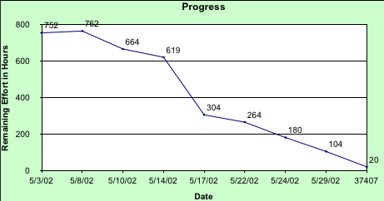
Sprint Burn down Chart

Slide 113
Sprint Burnup Chart

Slide 114
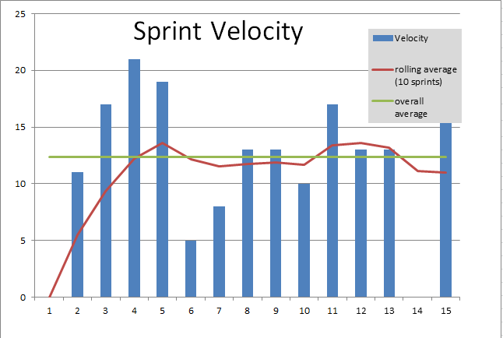
Velocity Chart
Using Velocity badly can cause Technical Debt

Slide 115
Introspection
Few high priority tasks or Projects might take a 1/2 day longer than the current sprint cycle.
How to plan the sprint delivery in that case?
How to get velocity and Burndown correct in that case?

Slide 116
Release Burnup Chart

Slide 117
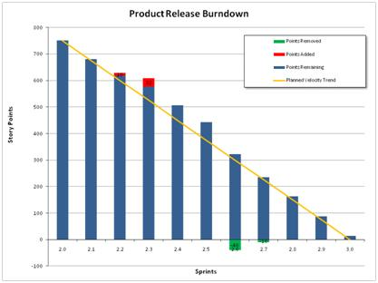
Product Release Burndown
Management
Visualize the overall project timeline and calculate total project costs.
Management can also see from a release burndown chart when extra sprints were added because remaining work has been re-estimated or work has been added.
They can also see the affect of other factors (such as changes in the team’s velocity or membership) on the long-term project outlook.
Product Owner
Team is progressing faster than planned, they may have the option of pulling in lower priority work from the backlog.
Team is not completing as much as planned in each sprint, the product owner may opt to de-scope some of the project, re-prioritize the backlog, or look to project sponsors to increase the length of the project or add project resources.

Slide 118
Enhanced Burndown (Converging)

Slide 119
Enhanced Burndown (Non-converging)

Slide 120
Value Burndown/Up Chart

Slide 121
Product Status

Slide 122
Running Tested Features
The RTF graph should look like , as the team should be adding features early and often and consistently
If it looks like , there might have been too much waterfallish behaviour going on – merits a conversation
This behavior indicates that things broke, and tests were failing. Questions must be asked
A story is said to “pass” if all of its acceptance tests pass Otherwise, it fails
It treats all stories as “equal”; that is, no story is worth more than another – they all provide equally to the count

Slide 123
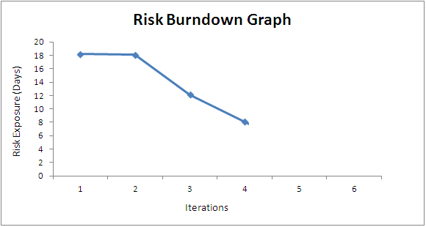
Risk Burn-down Graph
Actual Risk Trend line
Ideal Risk Trend line
If actual risk trend line is above than ideal trend line then it means risks are not coming down at the appropriate rate

Slide 124
Agile Health Checkup
To know the agile maturity in your project you can perform following Agile Health Checkup. Discuss in group and ask team to rate these parameters on the scale of 1-5
Frequent Delivery
Reflective Improvement
Close Communication (does it take less than 1 min to get you question answered by a person who know the answer?)
Focus (everybody understand the goal and desired outcome of the delivered software?)
Personal Safety (can you give bad news to your boss?)
Easy Access to Outside Experts
Strong Technical Environment (SVN used? Test Automation?)
Sunny Day Visibility (Does everyone on the team understand the rate of progress being made on the product?)
Regular Cadence or Rhythm (Is heartbeat of the system on?)

Slide 125
Important Concepts in Agile

Slide 126
When does Agile Methodologies Works Best?
When problems you are solving have
following characteristics
– Going to change while solving
– Speed of development cannot be determined
– Turbulence in environment
– Customer doesn’t know how exactly it will look
like

Slide 127
Technical Debt
While writing code agile programmer do not pay attention to structure, duplication etc but to functionality and make sure that code is passing all unit test cases
In this process if they do not clean the code by structuring (refactoring) it will become unreadable and un-maintainable and over a period of time this cause increases response time to fix the problems, adding new feature and deteriorate the quality.
The concept of unclean code is called technical debt. Technical debt keep increasing over the period of time therefore Agile team need to pay this debt back by putting efforts in refactoring.

Slide 128
Travel Light
Simple Design (Do Simple Things). Simplify Vigorously
You Aren’t Gonna Need It (YAGNI),
Once And Only Once (DRY),
TAGRI (They aren't gonna Read It)

Slide 129
Osmotic Communication
Agile project relies on collocation, minimum documentation, least reporting, maximum constructive engagement. This can be achieved if frequently sought important information is available in published form in team space
Whoever need the information can go and get the information without wasting time in requesting, making, sending, receiving the information
Benefits
Least cost, effort and time waste in communication
Updated information is always available without making new reports
People can get whatever particular information they are looking for
Happens at the same time
Feedback loop is quick
Those people who are left in regular reporting also get benefitted
No junk, old, repetitive information, but fresh and useful.
Dis-benefits
Some people get extra information which they do not need
It is left to individual’s interpretation

Slide 130
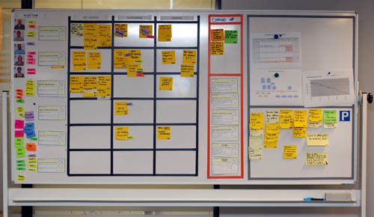
Information Radiator
Team Members
Work Progress
Impediments
Work Progress
Work Completed
Parking Lot

Slide 131
Time-boxing
Iteration length is time-boxed.
Following sequence of activities takes place in any time-boxed iteration
Grooming product backlog (done by product owner, in parallel to iteration work)
Iteration Planning (1 hour for every week of iteration)
Daily stand-up (15 min, max 2 min for one person, typical team size of agile team is 7±2)
Regular iteration work
Iteration Review (1 hour for every week of iteration)
Iteration Retrospective (1 hours for every week of iteration)

Slide 132
Overall Plan of This Workshop (5/5)
Scaling Scrum
Different teams of the same product at same location.
Different teams of the same product at different location, time zone
Different versions of same product for different customer
Tools in Agile Project
Existing Tools/Framework
How to Implement Agile in Jira
Devops
Recap (1 hr)

Slide 133
Scaling Scrum

Slide 134
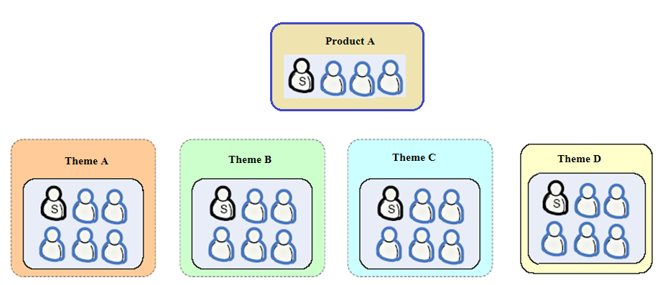
SCRUM of SCRUMS

Slide 135
Scrum of Scrums
Scrum

Slide 136
Introspection
How to involve multiple scrum team of the same program/project at different location, TZ?
How to effectively resolve the impediments during the sprints when SoS is happening?

Slide 137
Daily Standup in SoS
What my team did since we met last time
What my team planning to do till we meet next time
X is the impediment on the way of my team
What I am going to put before another team way?

Slide 138
Tools for Agile Project Management

Slide 139
Tool Support for Scrum
Doing Scrum requires no tools
Using a tool will not make you do Scrum
Identify your metrics and reporting needs first
Find tools that work with you
Start simple and stay that way
Find tools with unobtrusive touch points
Assign Tool monitor to handle tool usage

Slide 140
Type of Tools Used by Agile Teams
Collaboration Tools
Whiteboards, wiki, NetMeeting
Communication Tools
Talking, eMail, IM, video conferencing
Management Tools
Big charts, spreadsheets, tracking tools, Jira, Joho, VersionOne, AgileCraft, Microsoft TFS
Development Tools
Version control, build (Ant), automated testing (xUnit, Fit), integration (Cruise Control), IDE w/refactoring support (Eclipse, RefactorIT)

Slide 141
Scrum Smells When....

Slide 142
Scrum Smells !
Loss of Rhythm
Symptom: Sprints are not always the same length.
Talking Chickens
Symptom: Chickens attending the daily Scrum are allowed to ask questions or make observations.
Specialized Job Roles
Symptom: A project team has highly specialized job roles or descriptions such as Architect, Designer, DBA, or Tester

Slide 143
Scrum Smells !
Missing Pigs
Symptom: Not all pigs attend the daily Scrum Meeting
Persistent Signatures
Symptom: The wild fluctuations shown on a team's initial sprint burndown charts continue to be seen in much later sprints
ScrumMaster Assigns Work
Symptom: Work is assigned by the ScrumMaster rather than signed up for by developers.
The Daily Scrum is For the ScrumMaster
Symptom: The Daily Scrum Feels like it is a status update from the team members to the ScrumMaster

Slide 144
Jira @ VGL

Slide 145
DevOps

Slide 146
Agile Agreement
The Product owner promises the team that she/he will supply an initial product backlog
The product owner promises the team that he/she will prioritize the product backlog when needed
The product owner promises that an empowered "voice of customer" will be provided to answer business domain question promptly (minutes/hours, not days)
The ScrumMaster promises to keep the team healthy by focusing on the removal of impediments, both internal and external
The ScrumTeam promises that its work will be transparent, that it will make decisions and solve problems as a group, and that no individual team member will be left behind
Each member of the scrum team promises that they will bring issues, problems, impediments and realities encountered to the ScrumTeam.
Signed By:
Organization
Signed By:
Scrum Team

Slide 147
Agile Agreement
The ScrumTeam promises the stakeholders that there is product owner on the ScrumTeam driving the ScrumTeam based on stakeholder interests.
The ScrumTeam promises to use the stakeholders' time wisely, by focusing on questions that are relevant to the work being done now.
The ScrumTeam promises to deliver demonstrable product at the end of every sprint for review and validating by the stakeholders
The ScrumTeam promises that they will do quality work the best way they know how within the constraints set forth by the organization.
The organization promises the ScrumTeam that there are stakeholders (including SME) who will help when needed
The organization promises that they will help the scrum master in the removal of impediments to the scrum team's progress
The organization promises the ScrumTeam that they will not change prioritize or constraints in the middle of a sprint without ScrumTeam's consent.
The organization promises that being on a Scrum Team will not hurt of members careers.
Signed By:
Organization
Signed By:
Scrum Team

Slide 148
Recap
Agile Values & Principles
Scrum Values
Scrum Roles : PO, SM, DT
Scrum Documents : User Stories, Backlog (Product, Release, Sprint) , Burn Up/Down Charts, Kanban
Scrum Ceremonies: Daily Standup, Sprint Planning, Sprint Review, Sprint Retrospective, Product Backlog Grooming
Agile Concepts: Refactoring, Travel Light, Agile Documentation
Agile Team
Agile Metrics
Agile Scaling

Slide 149
Final Test

Slide 150








Reach Me
hari.prasad@vedavit-ps.com
+91 9535999336
https://in.pinterest.com/harithapliyal
https://www.instagram.com/thapliyal.h
https://in.linkedin.com/in/harithapliyal
http://twitter.com/pmlogy
http://pmlogy.com/
http://facebook.com/harithapliyalpage

Slide 151

Hari P Thapliyal,
Agilest & Project Management Trainer, Coach & Consultant
MBA, MCA, PGDOM, PGDFM, CIC, PMP, PMI-ACP, PRINCE2 Trainer, MCITP,
MCTS, CSM, SCT, MCT, SPOC, SMC, SAMC, ZED Master Trainer
For content related queries please contact me via
hari.Prasad@vedavit-ps.com
This document is proprietary and confidential. It remains the property of Vedavit Project Solutions at all times. No part of this document may be used, reproduced, or transmitted in any form or by any means electronic, including photocopying and recording, for any purpose without express consent of Vedavit Project Solutions.

